Slide 1


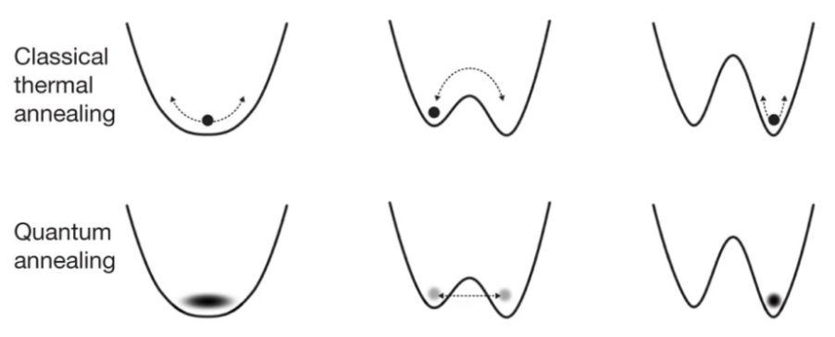
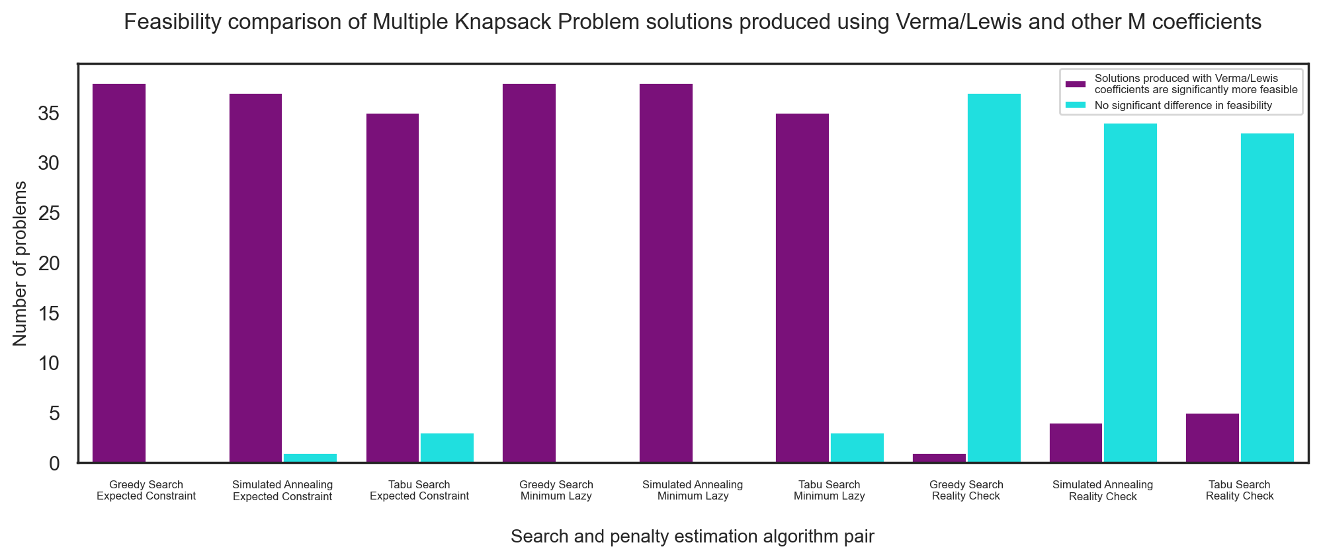
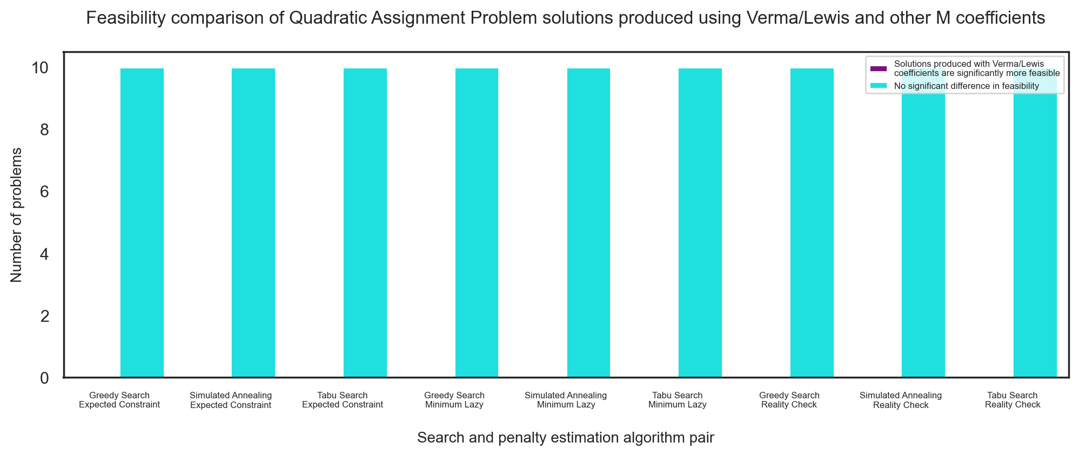

Estimating Penalty Coefficients For Quadratic Unconstrained Binary
Optimisation Problems
Raufs Dunamalijevs
Supervised by Professor John McCall
MOTIVATION
METHODS
CONCLUSION
Quadratic Unconstrainted Binary Optimisation (QUBO) is a way to formulate combinatorial optimisation problems. A QUBO problem can be mapped on a network of qubits and solved on a Quantum Annealing device, which can take advantage of quantum tunnelling when exploring the fitness landscape.
We have implemented two new penalty estimation algorithms. Both are based on the Verma and Lewis (VL) approach that produces the estimated lower bound of the penalty coefficient. We have tried to improve its weak point and have taken into account the penalty function structure.
Our first algorithm (Expected Constraint) calculates the expected penalty if it were imposed by counting the amount of penalty each decision variable is associated with and then dividing it by the total number of the variables. We then divided the VL prediction by the expected penalty to return a reduced lower bound.
The second algorithm (Minimum Lazy) is similar to the first one, but instead of finding the total expected penalty, we find the minimum penalty associated with any of the variables.
Finally, we made an algorithm that always returns half of the predicted VL lower bound, so we can find the problems for which VL definitely returns an overestimated coefficient. As most of the time, other algorithms produce numbers that are much smaller than the VL prediction, we do not always see if we are running into the other extreme: underestimating the penalty coefficients. That is why we need this Reality Check.
While VL lower bounds can be used effectively in Multiple Knapsack Problems, it has been shown that Quadratic Assignment and Travelling Salesman Problems produce feasible solutions with M’s that are much lower. Moreover, even in most Multiple Knapsack Problems, halving VL coefficients will still produce solutions of similar feasibility in most cases. This result means that the predicted bound in many cases is not the actual lower bound as was theorised. Empirical demonstrations suggest that other methods could be more effective in finding penalty coefficients. We have produced a list of problem instances from three different datasets that are likely to have smaller lower bounds than the ones predicted by VL. Potential future work can include identifying whether the algebraic forms of these problems have something in common. If it is possible to identify such QUBOs quickly, a one-for-all method could be made to produce better penalty coefficients.
In QUBO, constraints of the problem transform into a penalty function, which worsens the objective value if it is infeasible. The penalty coefficient (M) controls the degree to which the penalty function will influence the overall fitness. If M is too low, the broken constraints will be undervalued, and the solution produced will be infeasible. If the M is too large, the penalties will overwhelm the objective function making it harder to differentiate between good and bad solutions. The current state of the art gives theoretical feasibility guarantees at the expense of overestimating M.
RESULTS
KEY PAPERS
Glover, F., Kochenberger, G. & Du, Y. (2019), ‘Quantum Bridge Analytics I: a tutorial on formulating and using QUBO models’, 4OR 17(4), 335–371.
Verma, A. & Lewis, M. (2020), ‘Penalty and partitioning techniques to improve performance of QUBO solvers’, Discrete Optimization p. 100594.
Kochenberger, G., Hao, J. K., Glover, F., Lewis, M., L¨u, Z., Wang, H. & Wang, Y. (2014), ‘The unconstrained binary quadratic programming problem: A survey’, Journal of Combinatorial Optimization 28(1), 58–81
PROJECT AIMS
Study the existing methods of estimating M and critically evaluate them.
Implement one of them.
Propose and implement new algorithms for estimating M.
Generate M for a variety of QUBO problems using implemented algorithms.
Solve the QUBOs using generated M’s.
Compare the quality of the produced solutions.

